Slide 1

POULTRY SCIENCE:
Reproductive Physiology & Egg Development
Unit 6

Slide 2
Poultry Science:
Reproductive Physiology & Egg Development
Unit 6: Segment 1
Male Reproductive System

Slide 3
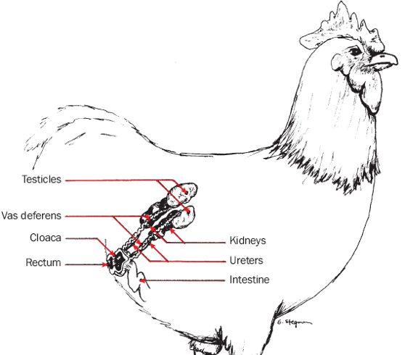
Avian Male Reproductive System
Paired testes
Poorly developed epididymis
Vas deferens
Rudimentary phallus

Slide 4
Hormone Regulation
Photoperiodic Control
  Perceives changes in day length
  Stimulates HPG axis
Gonadal Changes
  Growth and regression
Secondary Sex Characteristics
  Comb and wattle growth and coloration change
Feather Changes
  Grow long hackles, sickle, and saddle feathers

Slide 5
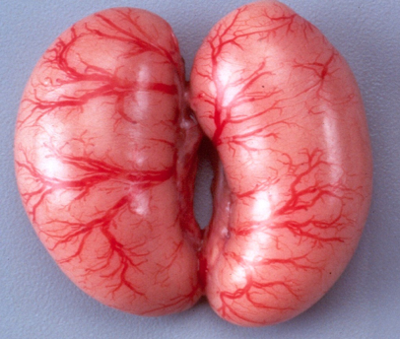
Testes
Testes (pair) are located on the back wall just above the kidney within the abdomen.
Constitutes 1% of body mass in most birds.
  2-3% in Quail
Left testis is usually larger than the right, reason being is unknown but testicular size is related to male competition.

Slide 6
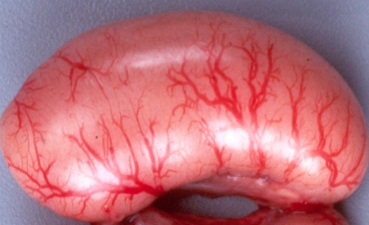
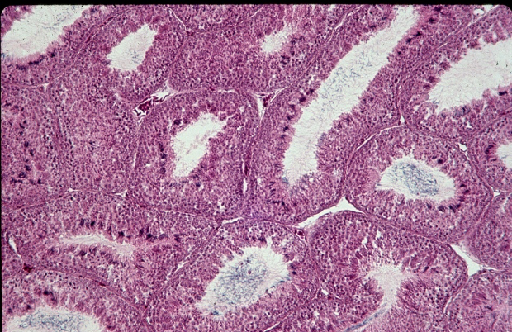
Structure of a Testis
Birds have a poorly developed epididymis
In mammals, the epididymis acts as a sperm storage area (up to 60 days), absorbs fluid, sperm mature (swim)
Site of sperm production
Made up of many clusters of tubes or seminiferous tubules

Slide 7
Testis: Seminiferous Tubule
Leydig Cells
Responsible for testicular androgen production
Sertoli Cells
“Nurse Cells”
Sperm maturation
Provide nutrients and the optimal environment as well as consume damaged sperm

Slide 8
Hypothalamus
-
GnRH (Gonadotrophin Releasing Hormone)
Anterior Pituitary
-
-
FSH
LH
Sertoli Cells
Leydig Cells
Inhibin
Regulates Sperm production
Testosterone

Slide 9
Spermatogenesis
Spermatogenesis – maturation to functional sperm
Spermatozoa produced in seminiferous tubules
Effected by temperature
  Bird sperm is more tolerant of high temperatures
Time to maturation:
  13 days in birds
  34-75 days in mammals
  Little sperm storage in birds and seasonal breeding

Slide 10
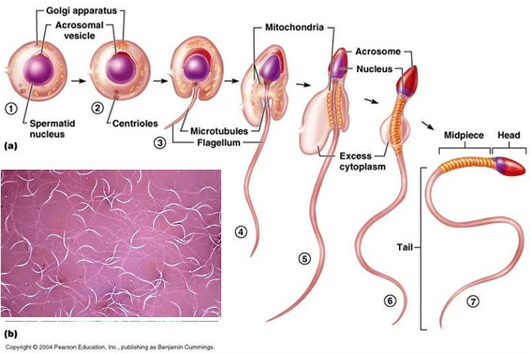
Spermiogenesis
Morphological changes
  Spermatid to spermatozoa
  Formation of the acrosome cap and tail

Slide 11
Transport of Semen
Vas Deferens
Wavy ducts that run along urinary duct
Transports sperm to cloaca for ejaculation
  Duration of 20-30 days non-sexually active
  Only 1-3 days in sexually active males
Enlarged near the cloaca
  Stores a small amount of semen
    Mammals: sperm storage in testis and epididymis for duration of 60 days

Slide 12
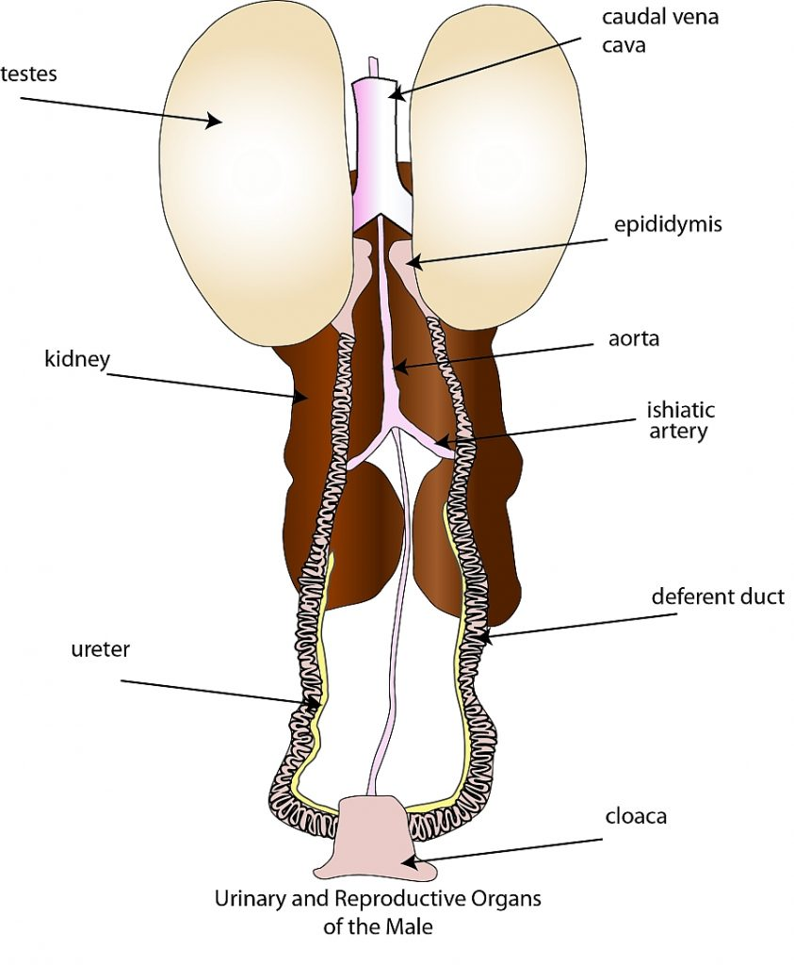
Avian Phallus
Rudimentary Penis
  Absence of a true intromittent penis in the chicken, turkey, and quail (no penis)
  Lymph fluid adds to sperm (semen)
  Chickens, turkeys, pheasant, and quail have a V-shaped phallus
  Waterfowl and ratites have a more well-developed corkscrew-shaped phallus

Slide 13
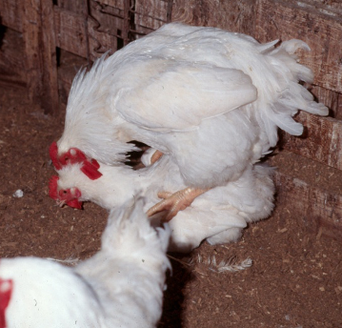
Mating
Since the rooster has a rudimentary penis, he must have close cloacal contact with the hen for semen to be passed to her (insemination).

Slide 14
Summary of Differences:
Birds
No accessory glands
Highly concentrated semen
Small ejaculate volume
Internal testis
Large testes to weight ratio
Little semen storage
No capacitation
Mammals
Accessory glands
Low concentrated semen
Large ejaculate volume
External testis
Low testes to weight ration
Semen stored in testis and epididymis
Capacitation required

Slide 15
Poultry Science:
Reproductive Physiology & Egg Development
Unit 6: Segment 2
Female Reproductive System

Slide 16



Slide 17
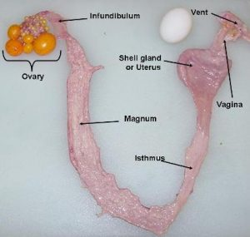
Avian Female Reproductive System
Left Ovary
Left Oviduct
Single Egg (Ovum) is produced every day
Follicle does not form a corpus luteum after ovulation
Sperm storage tubules
OVIDUCT

Slide 18

Oviduct of a Laying Hen
Infundibulum – site of fertilization
Magnum – secretion of egg albumen
Isthmus – secretion of inner and outer shell membranes
Shell Gland – shell formation
Utero-Vaginal Junction – location of sperm host glands for sperm storage
Vagina – passageway to cloaca and site of sperm selection

Slide 19
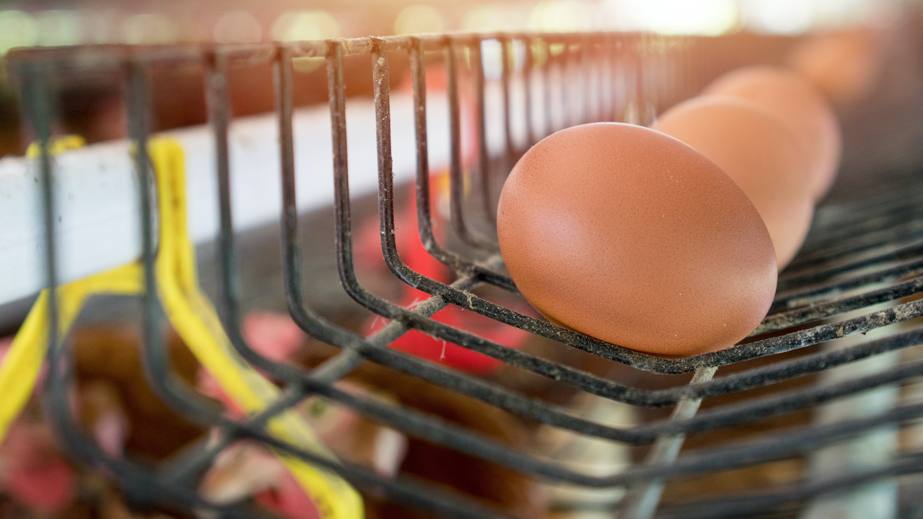
Ovarian Development
First 14-15 weeks of life there is not much happening in the female reproductive system.
Around 15 weeks, the hypothalamic/pituitary axis matures, allowing for:
  Photostimulation (long day length) is the message to start egg production
  Secondary sexual characteristics
  Ovary and oviduct growth and development
  Female must be at an appropriate body weight to respond to Photostimulation (proper nutrient intake)

Slide 20
Hormonal Control
Photoperiodic Control
  Perceives changes in day length
  Stimulates HPG axis (“Photostimulation”)
Gonadal Changes
  Growth and regression
  Ovary
    Follicle Stimulating Hormone (FSH) – gets the follicles going by stimulating Theca cells of the small follicles to produce estrogen
    Luteinizing Hormone (LH) – stimulates granulosa cells to produce progesterone
  Oviduct
Secondary Sexual Characteristics
  Comb color and size

Slide 21
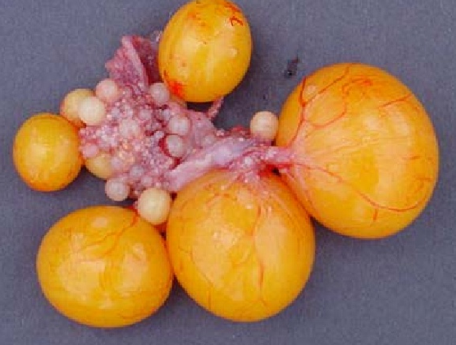
Follicular Development
Begins with small, white follicle
These grow to become small, yellow follicles
Next, the SYF are selected to become large yellow follicles for hierarchical follicles
  F₁ will ovulate around 24 hours, and F₂ in 48 hours

Slide 22
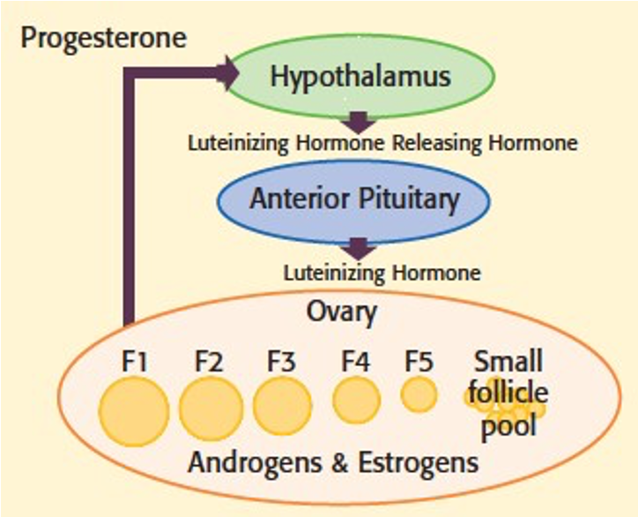
Follicular Development
Ovarian follicles develop and mature -> graduated sizes, with various sizes having different functions
Theca cells of small, white, immature follicles produce estrogen and androgens
Granulosa cells produce progesterone

Slide 23
Oviduct Function
Capture ovulated ovum
Site of fertilization
Transport and expulsion of ovum
Sperm storage
Site of early embryo development
Secretion of albumin, fluids, shell membranes, shell, and shell pigments

Slide 24
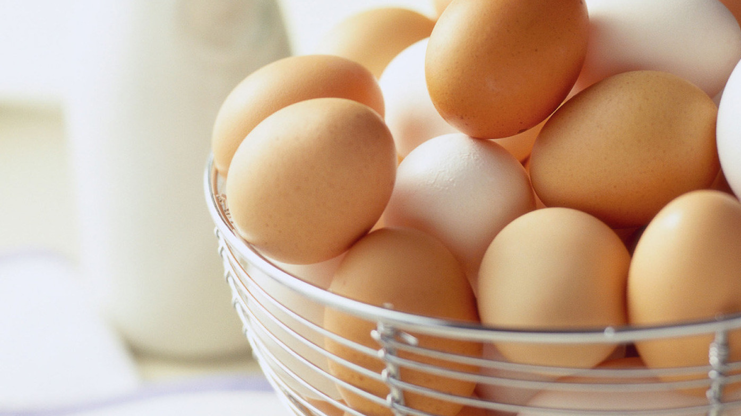
Internal Layer
The infundibulum doesn’t always pick up the follicle…
  When this happens, the follicle drops into the abdomen and the body tries to reabsorb it, but this can lead to abdominal infections.

Slide 25
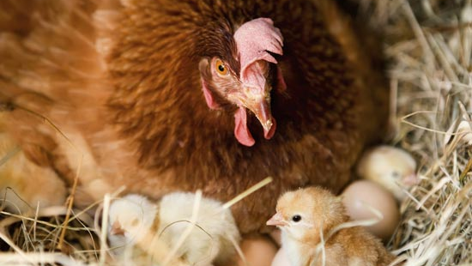
Requirements for Successful Natural Fertilization
It is suggested that only one of the following conditions be met to ensure successful fertilization:
  Long fertilizable life span for ova and/or sperm
  Accurate synchronization between copulation and ovulation
  Copulations must occur frequently to ensure viable sperm at the time of ovulation

Slide 26
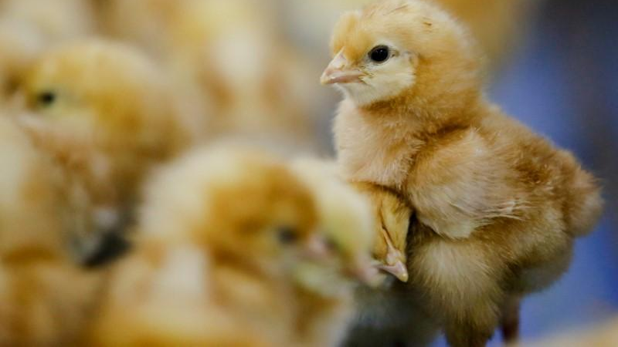
Requirements for Successful Fertilization
Synchronization between ovulation and oviposition -> ovulation of the next follicle occurs approximately 30 minutes (15-75 min. range) after oviposition.
Sperm released from U.V.J. would have 20-30 minutes to traverse an empty oviduct and fertilize the next ovum to be ovulated.

Slide 27
Requirements for Successful Fertilization: Domestic Chickens
Long fertilizable life span of ovum: 15-30 Minutes
Long retention of fertilizing capacity by sperm: 10-14 Days
Synchronization between copulation and ovulation: None. No typical Estrus Cycle as in humans.
Ovulation induced by copulation: None.
Capacitation: None. Mammal sperm must incubate 3 hours before it an fertilize the egg.

Slide 28
Poultry Science:
Reproductive Physiology & Egg Development
Unit 6: Segment 3
Egg Development

Slide 29
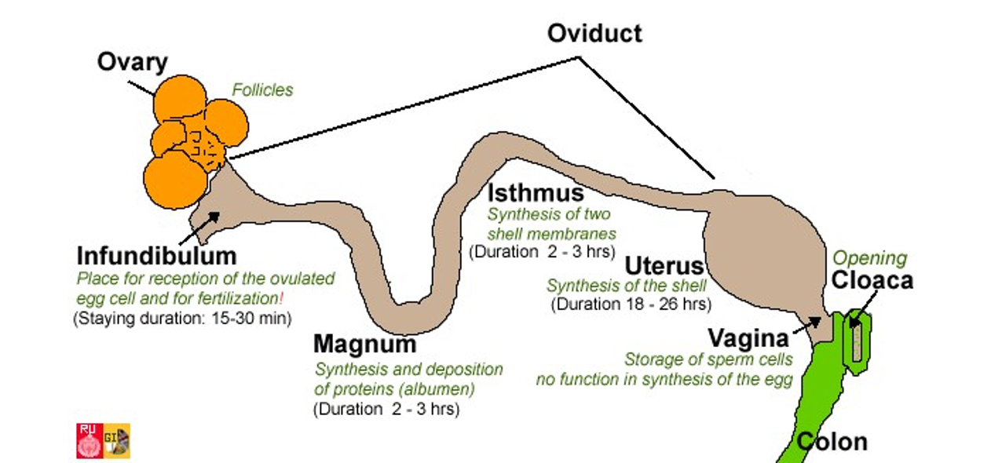
Egg Formation

Slide 30
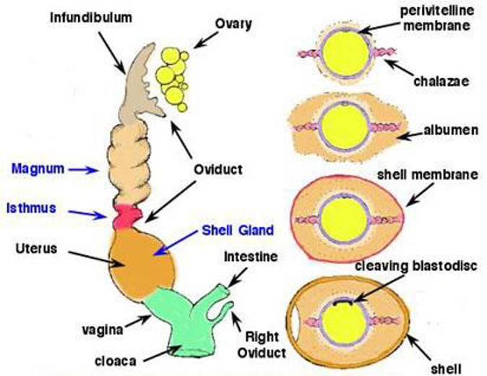
Egg Formation

Slide 31
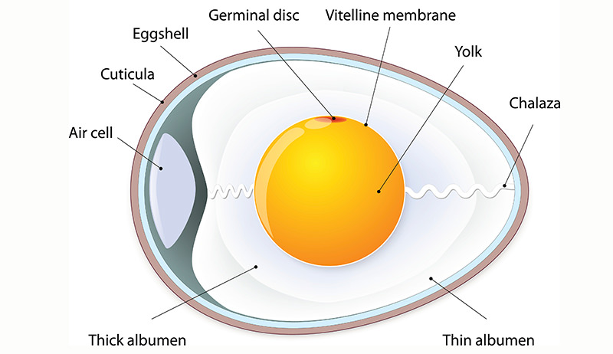
Egg Structure
Shell
Shell Membranes
Thin Albumen
Thick Albumen
Yolk
Germinal Disc
Chalaza

Slide 32
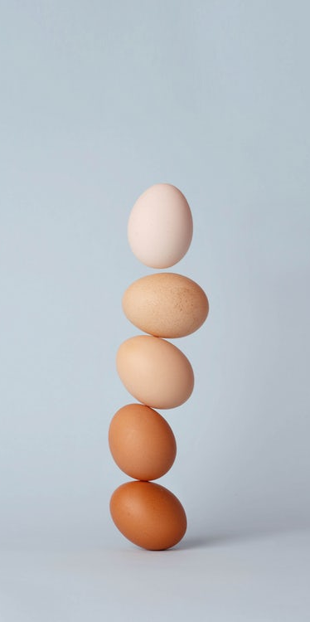
Egg Laying
Hens lay clutches (number of eggs laid in a row) of eggs followed by a pause or “skip day”, and may be one of two situations:
Once a pattern has been established, birds will stick to it, especially chickens.
With chickens, if you take their eggs away every day, they will have a continuation of lay period with an occasional skip day.
If you do not remove the eggs daily, the hen will become broody and discontinue laying.
Notes:
Hens lay their eggs in sequences of rom 1 to more than 300 ovipositions that, by definition, are laid on consecutive days. Under conventional photoscheduels in light controlled buildings, the first egg of a sequence is laid within a few hours after the lights come on (dawn) and the last egg of a sequence is laid about eight hours later in the photschedule. Intervening eggs in a sequence are laid at progressively later times in the photoschedule so that each successive egg is laid at a slightly later time in the day than its predecessors.
The restriction of oviposition to an 8h period of the day is believed to be the consequence of a circadian rhythm which facilitated the preovulatory hormonal cascade releasing the egg yolk from the ovary to an equivalent 8h period.
Examination of the times of oviposition reveals that eggs are laid at slightly later times during each consecutive day. It is generally accepted that the advance in the time of oviposition is a feature of the ovulatory sequence because maturation of the ovulating follicle usually requires slightly more than 24 hrs. Hens that lay long sequences have very rapid rates of follicular maturation and have high rates of lay where those with short sequence have low rates of maturation and low rates of lay.

Slide 33
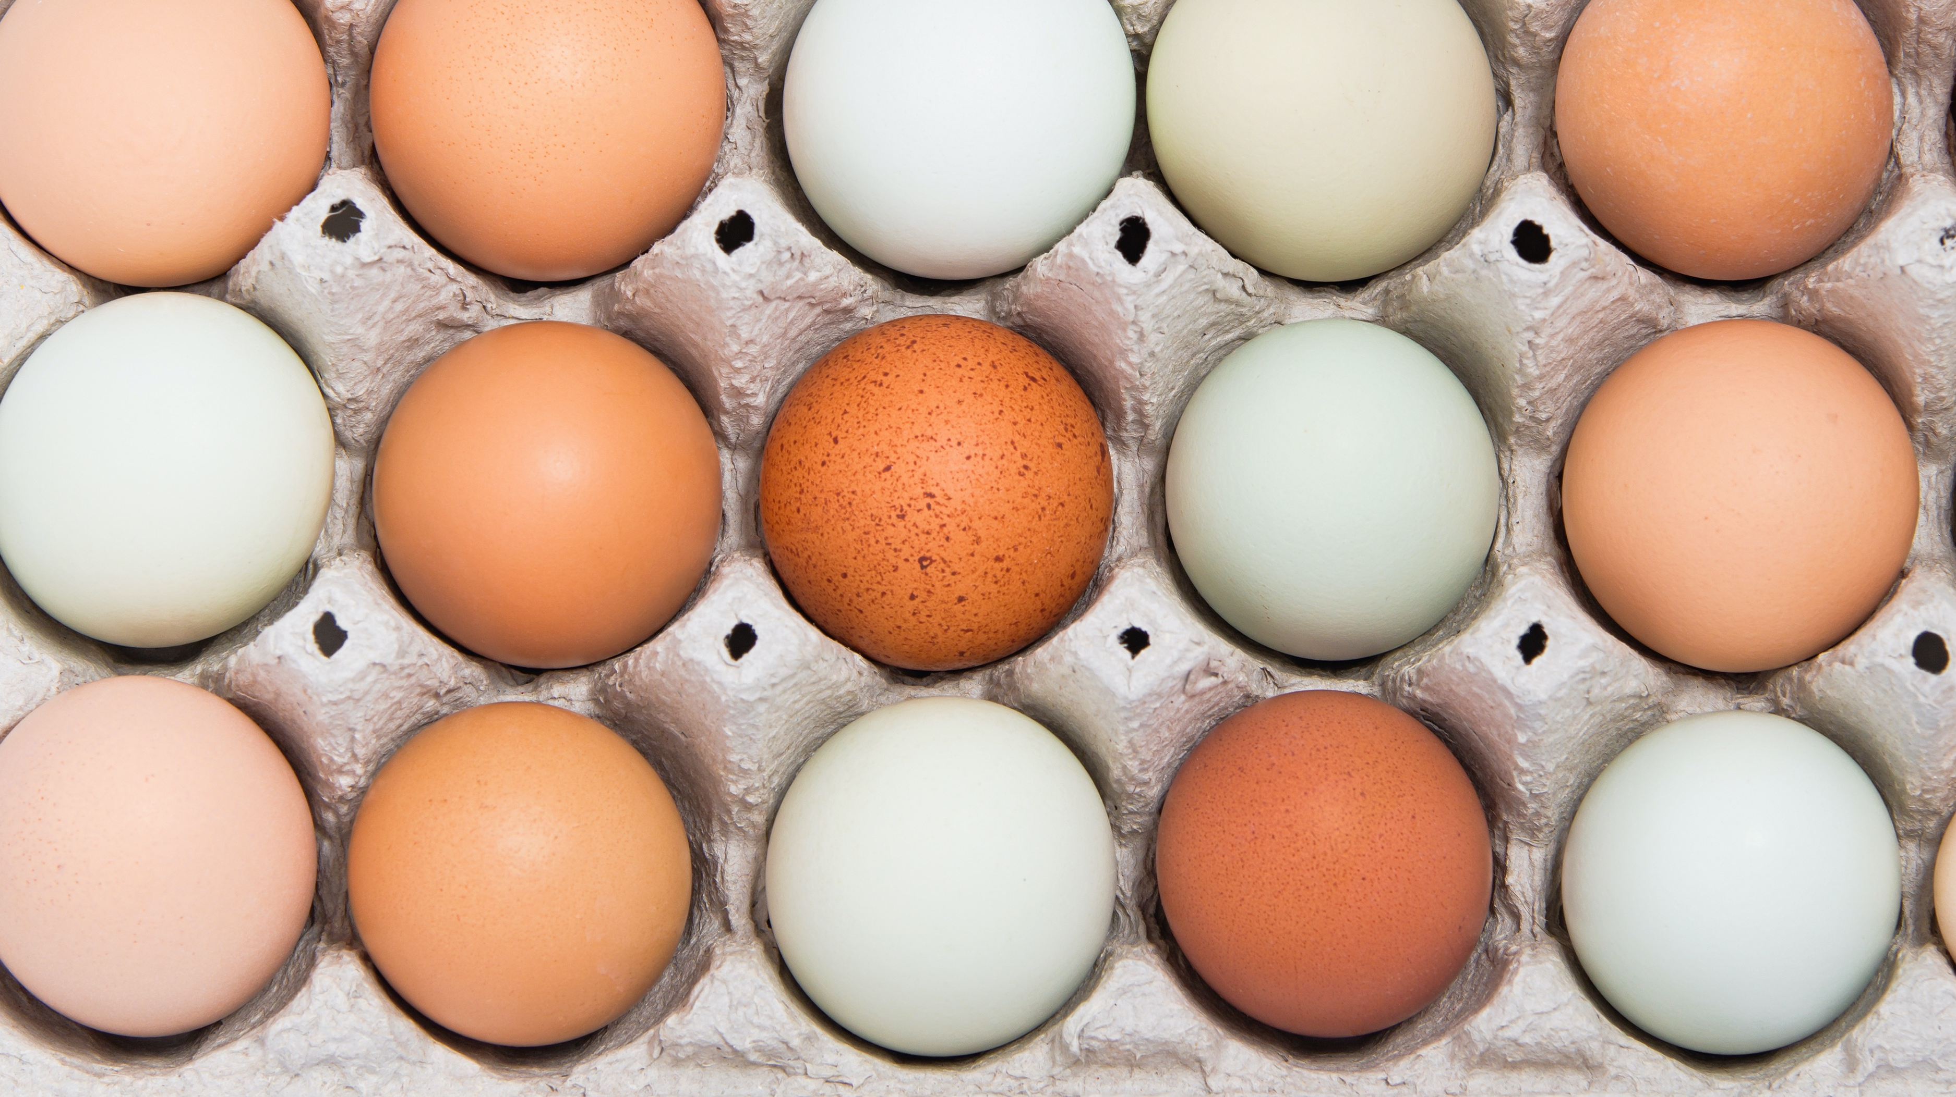
Egg-cellent Facts
An egg contains approximately 10,000 pores that allow for the diffusion of gases through the pores.
In order to minimize water loss from eggs during storage for both table and hatching eggs, it is important to store them at 75-85% humidity.
In Grade-AA eggs, the air cell may not exceed 1/8” in depth and is about the size of a dime.
Grade-A eggs may have air cells over 3/16” in depth, but there is no limit on air cell size for Grade-B eggs.

Slide 34
Poultry Science
Curriculum References
Jessica Fife, UGA Dept. of Poultry Science Outreach Coordinator, UGA Dept. of Agricultural Leadership, Education, & Communication MAEE Candidate
Barry Croom, UGA Dept. of Agricultural Leadership, Education, & Communication Professor
Ashley Yopp, UGA Dept. of Agricultural Leadership, Education, & Communication Assistant Professor
Georgia Agriculture Education
Andrew Benson, UGA Dept. of Poultry Science Assistant Professor
Brian Jordan, UGA Dept. of Poultry Science Assistant Professor, UGA College of Veterinary Medicine Assistant Professor
University of Arkansas Bumpers College of Poultry Science – Poultry Science Dual Curriculum Course
Julia Gaskin, UGA Dept. of Crop and Soil Sciences Sr. Public Service Associate
Glendon Harris, UGA Dept. of Crop and Soil Sciences Professor & Extension Agronomist
Brian Kiepper, UGA Dept. of Poultry Science Associate Professor
Claudia Dunkley, UGA Dept. of Poultry Science Public Service Associate
Casey Ritz, UGA Dept. of Poultry Science Professor
USPOULTRY & USPOULTRY Poultry Science Curriculum
Tom Tabler, Mississippi State University Department of Poultry Science Extension Professor
Jacquie Jacob, University of Kentucky
Jeanna Wilson, UGA Dept. of Poultry Science Professor
Kelly Sweeney, UGA Dept. of Poultry Science Ph.D Candidate
Merck Veterinary Manual
University of Maryland Extension
Poultry Hub
Brian Fairchild, University of Georgia Department of Poultry Science Professor
Centers for Disease Control
National FFA Organization

